Slide 1
Which IAC is Right For Me?

Slide 2
Audience
People who want to know what Infrastructure as Code (IAC) is
People who want to know why you use IAC
People who don’t know where to start with IAC
People new to the cloud
People who are using IAC but want to know different options

Slide 3
Agenda
History
What is Infrastructure as Code?
Why should you care?
All the options that are out there
Azure Bicep + ARM
Terraform
AWS Cloudformation + CDK
Pulumi

Slide 4
Goals
Understand what and why of IAC
Understand which IAC fits my environment

Slide 5

Who is Matt Phillips?
Technical Lead at Integrity
13 years in software
Uses multiple IAC technologies every day

Slide 6

Who is Scott Sauber?
Director of Engineering at Lean TECHniques
Microsoft MVP
Co-organizer of Iowa .NET User Group
Dometrain Author

Slide 7
In the Before Times
On-premises
Sysadmins maintained the infrastructure (pets)
Clickety Clack Configuration
“It works in Dev, but not in Production”

Slide 8
“It Works On My Machine” - Every Developer At Least Once

Slide 9
Then…
But then cloud replaced the datacenter (still pets)
Still Clickety Clack Configuration
“It still works in Dev, but still not in Production”
But now we don’t own the hardware!

Slide 10
What is Infrastructure as Code (IAC)
Source code that defined provisioning resources that’s configurable and repeatable across all environments
Stored in version control
Declarative – what resources to create, not how to create them
Deployed via automation (ideally pipeline, but could be local)
Resource properties can be linked together

Slide 11
Why IAC?
Promotes consistency and standardization
“It Works On My Machine” goes away
“It works in Dev, but not in Production” goes away
Audit trail of who did what and when
Resources are Transient not Permanent
Can be deleted and re-created with ease (besides your DB)
Standing up a new environment is a few lines of code and minutes

Slide 12
So what can I create with IAC?
Virtual Machines
Web Servers
Databases
Secret Stores
Networking
IAM Policies
Monitoring
DNS
…pretty much everything

Slide 13
Okay I get it …but how?

Slide 14
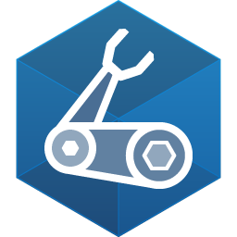
What is Azure Bicep?
Used to configure Azure resources
Built and maintained by Microsoft
Domain-specific language (fancy word for custom)
Provides intellisense, error checking, “whatif,” and orders the resource creations
Built on top of Azure Resource Manager (ARM) – don’t use ARM directly
No state file

Slide 15
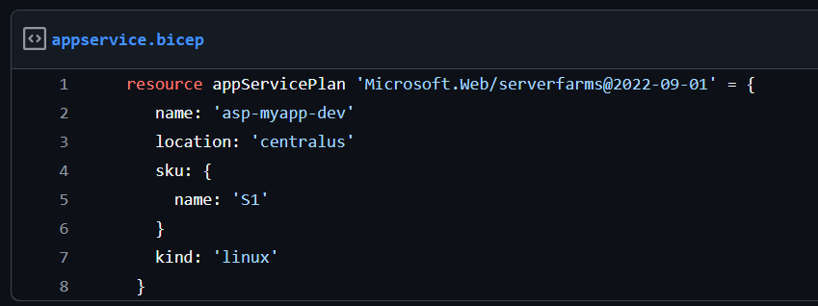
What is Azure Bicep?

Slide 16
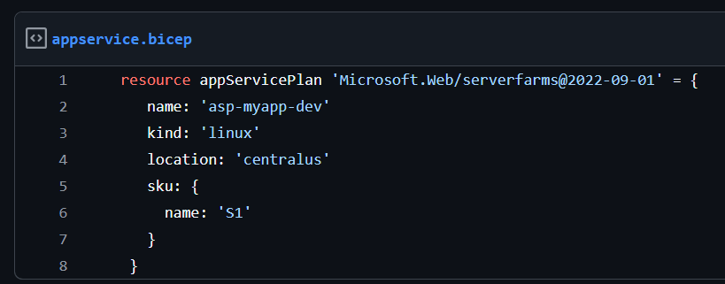
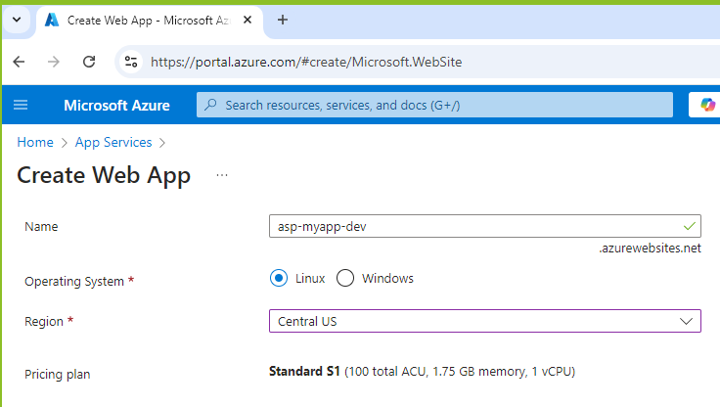

Slide 17
Demo
Notes:
Showing IAC
Show parameterizing
Show adding a new env

Slide 18

Terraform
Created by HashiCorp (recently acquired by IBM)
Domain-specific language
Configure different clouds (Azure, AWS, GCP, VMware, etc) via Providers
BUT – can’t take same Terraform and run it on both Azure and AWS
Maintains state of infrastructure via state file
Likely the most popular IAC tool in the world
Recently changed to less permissive BSL license
Recently acquired by IBM

Slide 19
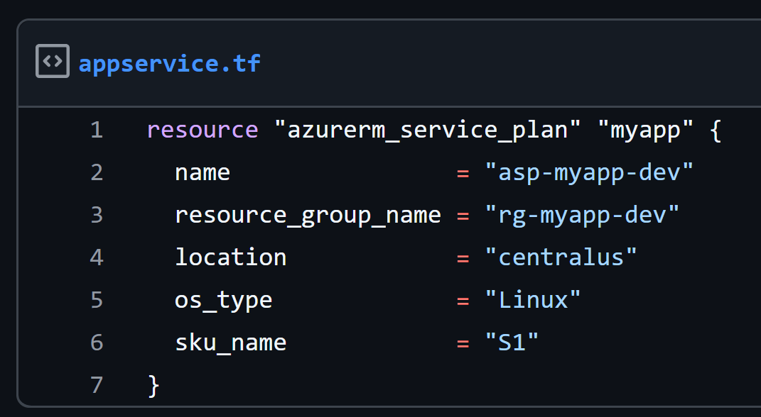

Slide 21
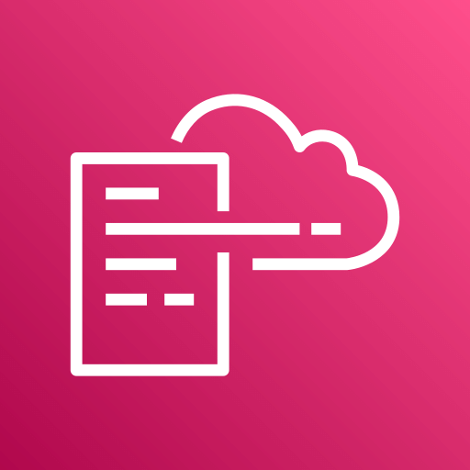
AWS Cloudformation
Used to configure AWS resources
Built and maintained by Amazon
YAML or JSON files

Slide 22
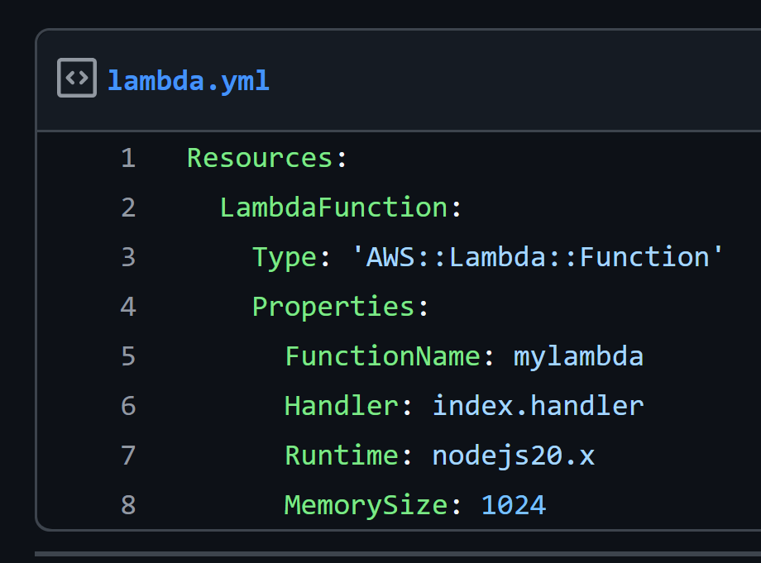

Slide 23

AWS CDK
Used to configure AWS resources
Built and maintained by Amazon
You write your language of choice – TypeScript, JavaScript, Python, Java, C#, or Go
Built on top of Cloudformation

Slide 24
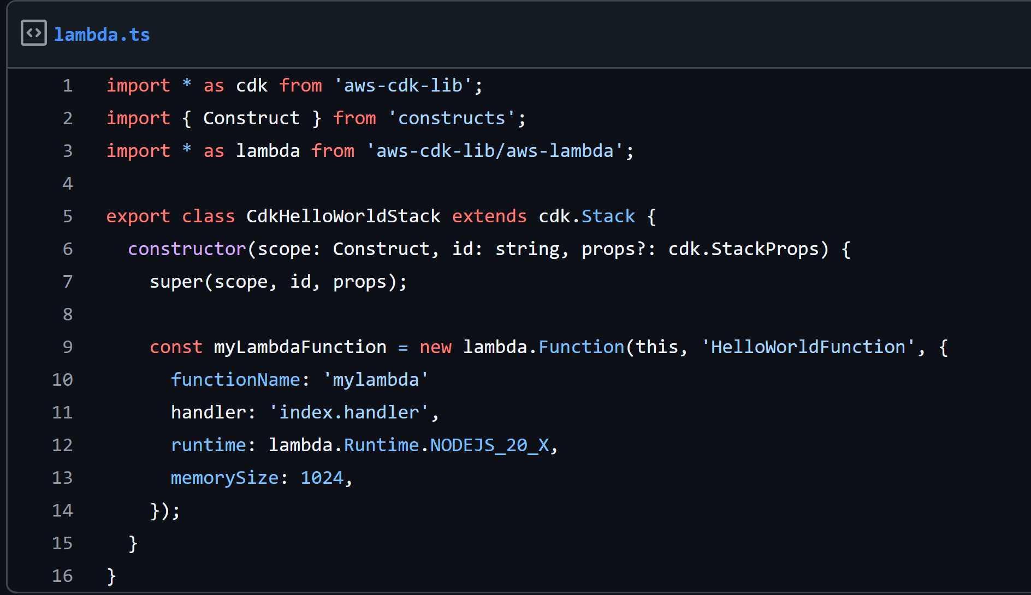

Slide 25

Pulumi
Created by Pulumi Corporation
Configure different clouds (Azure, AWS, GCP, etc)
You write your language of choice – TypeScript, JavaScript, Python, Java, C#, Go, or Visual Basic (yes really)
First big player to market with IAC using an existing language

Slide 26
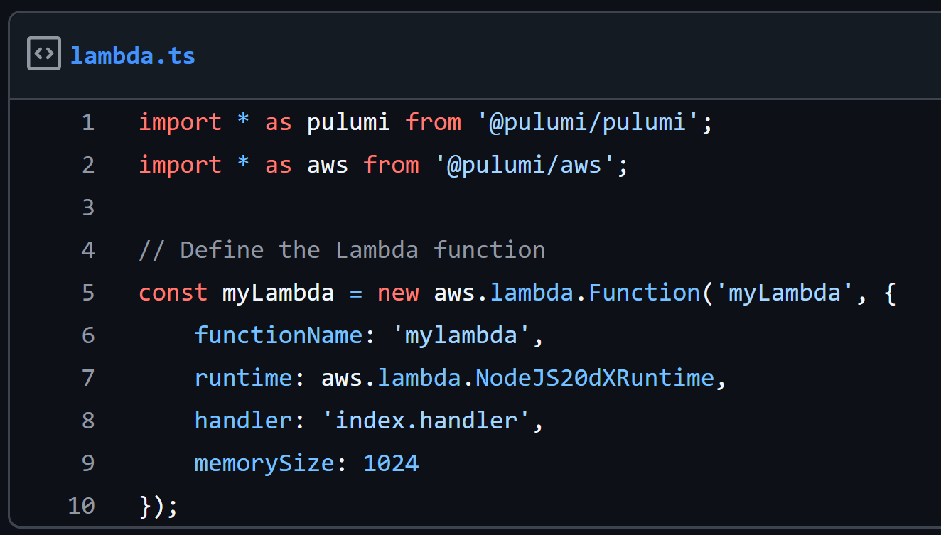

Slide 27
Configuration Files vs Code Files
Bicep, ARM, Terraform, and Cloudformation are DSL config files
CDK and Pulumi are libraries of existing languages
CDK for Terraform is CDK but built on Terraform, supported by Hashicorp
Configuration popular with Ops-focused teams
Code popular with Dev-focused teams
Code leverages existing skills – packages, syntax, autocomplete, etc

Slide 28
Okay I get it …but which do I pick?

Slide 29
Two main decisions
Do I go first-party with Azure/AWS/my cloud? Or do I go third-party like Terraform or Pulumi?
Do I choose a DSL config file based tech or GPL code file based tech?

Slide 30
DevSecOps
Integrate an IAC scanner into your CD pipeline
Catch security misconfigurations (ie require TLS 1.2, no public S3 buckets, etc) in a Pull Request before it hits your cloud
Checkov is a free tool, terrascan

Slide 31
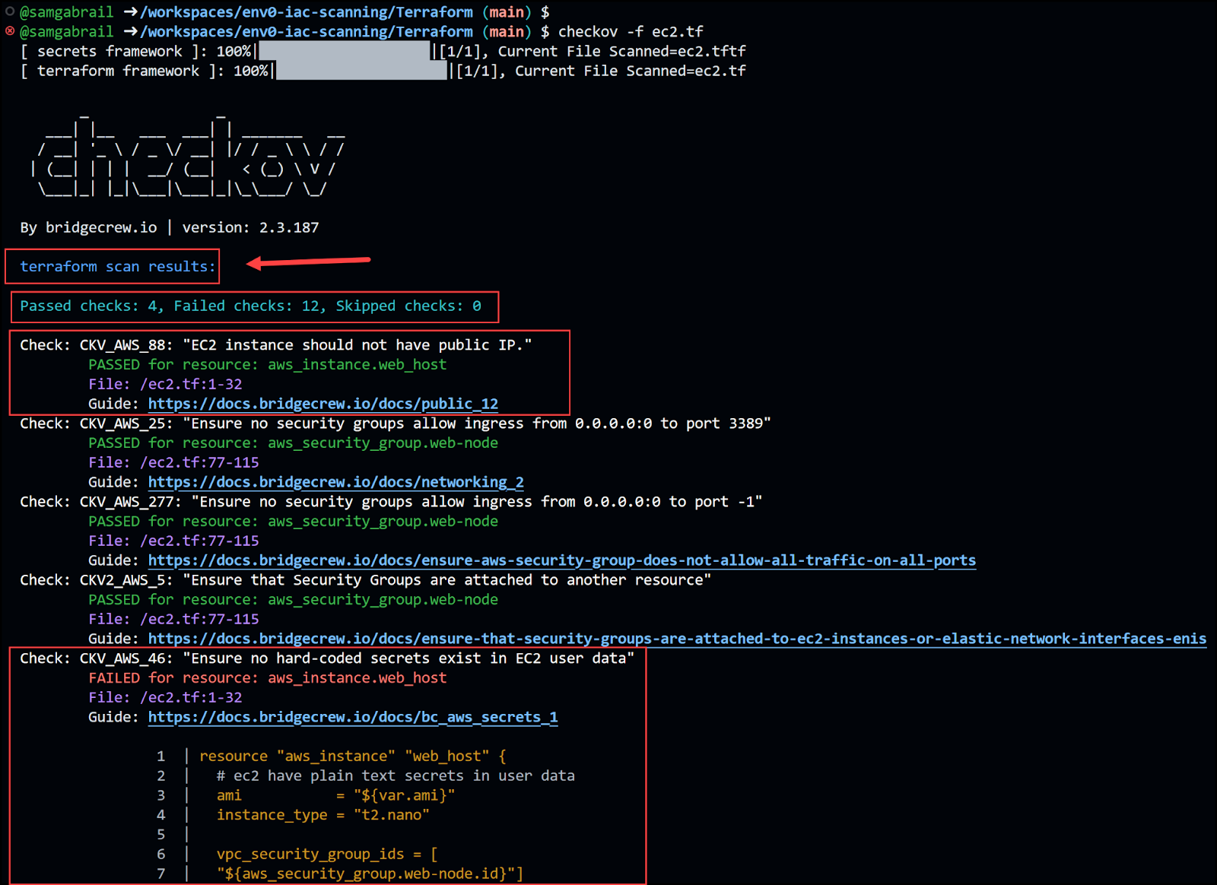

Slide 32
Takeaways
Understand what IAC is and why you should care about it
Understand which IAC might be a good fit for you
Use a security scanner for your IAC

Slide 33
Questions?

